Slide 1

How to valorize organic waste
Reusing, Reducing, Recycling

Slide 2
Lab. activity

Slide 3
1 - 1/2 hour cooking of vegetables for a soup
After this first activity, they have organic waste residue
Use of waste for new creative and sustainable recipies

Slide 4
Didactical activity in the classroom

Slide 5

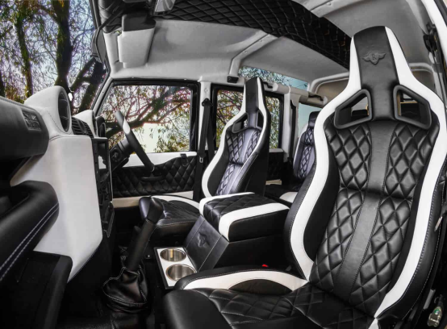

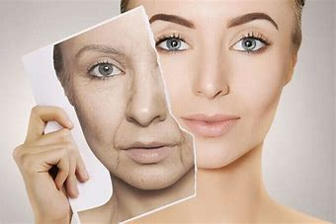
Visual (mind) map (using keywords)
Problem:
Wine by-products (skins, stems so on) trasformed in business opportunities
Fashion
Automotive
Cosmetics
Pharma
Grape Leather
Car interiors
Anti-wrinkle
Anti-ageing products

